Slide 1
PANIMALAR ENGINEERING COLLEGE DEPARTMENT OF COMPUTER SCIENCE AND ENGINEERING
DENSITY BASED AUTOMATIC TRAFFIC CONTROLLER SYSTEM
DOMAIN:EMBEDDED SYSTEMS
211418104204 (PRIYASAGI N)
211418104251 (SINDHUJA K)
GUIDED BY : Dr. K. VALARMATHI, ME., Ph.D., Professor.

Slide 2
INTRODUCTION
The project is aimed at designing a density based dynamic traffic signal system where the timing of signal will change automatically on sensing the traffic density at any junction.
Traffic congestion is a severe problem in most cities across the world and therefore it is time to shift more manual mode or fixed timer mode to an automated system with decision making capabilities.
Present day traffic signalling system is fixed time based which may render inefficient if one lane is operational than the others.
To optimize this problem, a framework is made for an intelligent traffic control system.
Higher traffic density at one side of the junction demands longer green time as compared to standard allotted time.
Therefore propose here a mechanism in which the time period of green light and red light is assigned on the basis of the density of the traffic present at that time.
The system proposed here is to identify the density of traffic on individual lanes and thereby regulate the timing of the signal.

Slide 3
LITERATURE SURVEY
S.NO | TITLE | AUTHORS & PUBLISHED YEAR | INFERENCE
1. | Smart Street Light Management System with Automatic Brightness Adjustment Using Bolt IoT Platform | Sk Mahammad Sorif, Dipanjan Saha, Pallav Dutta,2021 | This paper presents a streetlamp control system based on the Bolt IoT platform. Using LDR with LED lights the intensity can be controlled. IR sensors utilized on roadside send signals for the LEDs to get glowing for the next specific section of the road after sensing the density of vehicles. During daytime the LDR keeps the streetlamp off until the light level is low or the light frequency is low and the LDR resistance is high.
2. | GSM-GPRS Based Smart Street Light | Imran Kabir, Shihab Uddin Ahamad, Mohammad Naim Uddin, Shah Mohazzem Hossain, Faija Farjana, Partha Protim Datta, Md. Raduanul Alam Riad and Mohammed Hossam-E-Haider, 2021 | This model is structured using the GSM-GPRS shield. The whole model has the superiority to be controlled in full-automated, semi-automated and manual method. The GPRS part has the access to internet which can use the sunset and sunrise timing to allow the system to operate in full-automated method. The entire process is controlled by ATmega-328p microcontroller.

Slide 4
LITERATURE SURVEY
S.NO | TITLE | AUTHORS& PUBLISHED YEAR | INFERENCE
3. | Automatic Street Light Controller | Shreyas M. Paralikar, Sayali V. Mahajan, Nihal G. Kolage,Prof. Sulakshana B. Mane, 2021 | In this paper,illigent street lighting, also known as adaptive street lighting, slows down when no activity is detected, but flashes when movement is detected. The IR sensors Sense a movement on the road and sends signal to Arduino and thus respective LED’s are turned on. Each sensor have sequence of 3 LED’s. When 1st sensor senses the vehicle the first 3 led and turned on.
4. | IoT Based Energy Efficient Automatic Streetlight | Dr.Jayalakshmi B , Anjali V , Nithin Raj R , Nakul Nair , Rahul T M, 2020 | This paper explains the external brightness of the environment is sensed by the LDR and it is given to the Arduino as input and the LEDs brightness is adjusted correspondingly as the output.

Slide 5
LITERATURE SURVEY
S.NO | TITLE | AUTHORS & PUBLISHED YEAR | INFERENCE
5. | Internet of Things (IoT)-based, Solar Powered Street Light System with Antivandalisation Mechanism | Archibong, Ekaette Ifiok, Ozuomba, Simeon, Ekott, Etinamabasiyaka, 2020 | This paper presents an Internet of Things (IoT)-based solar powered street lighting system with antivandalisation Mechanism where the system is a stand-alone solar PV system which is self-powered. It automatically switches the street light ON and OFF utilizing the light dependent resistor (LDR) and saves power by utilizing infrared sensor (IR) together with the microcontroller to dim and brighten up the LED as at when required thereby increasing the life span of the lighting module.
6. | Arduino UNO Based Visitors Counting System for Vaccination Rooms | Sakshi Gupta, Sreenitya Mandava, B. Chandrakanth Reddy, 2020 | In this paper, Arduino is interfaced with an ESP32 Wi-Fi modem to connect with an internet router and access the cloud server. sensors. The Arduino passes the count of the visitors in the room to the cloud.

Slide 6
LITERATURE SURVEY
S.NO | TITLE | AUTHORS & PUBLISHED YEAR | INFERENCE
7. | Intelligent Traffic Light System Using Computer Vision with Android Monitoring and Control | Jess Tyron G. Nodado, Hans Christian P. Morales, Ma Angelica P. Abugan, Jerick L. Olisea, Angelo C. Aralar, Pocholo James M. Loresco, 2020 | This paper discussed an approach in developing traffic signaling system capable of prioritizing congested lanes based on real-time traffic density data using cctv photages and integrated with an automated and manual control ported in a mobile android-based application.
8. | A Hierarchical Framework for Intelligent Traffic Management in Smart Cities | Zhiyi Li, Reida Al Hassan, Mohammad Shahidehpour, Shay Bahramirad, and Amin Khodaei, 2019 | This paper explains traffic efficiency improvements can be achieved by the utilization of a closed-loop management system. Interactive simulations are conducted in this paper to examine the performance of the proposed framework in a real-world transportation system.

Slide 7
LITERATURE SURVEY
S.NO | TITLE | AUTHORS & PUBLISHED YEAR | INFERENCE
9. | A Hybrid Particle Swarm Optimization and Tabu Search algorithm for adaptive traffic signal timing optimization | Maryam Alami Chentoufi and Rachid Ellaia, 2019 | This paper a hybrid Particle Swarm Optimization and Tabu Search Algorithm for adaptive traffic signal timing optimization is proposed. a novel algorithm that uses the information of the particle best neighbour in updating velocity and position, a new way of moving for each particle depending on her best historical position and whether it is included in the Tabu list. Second, we prove the effectiveness of the proposed algorithm for solving the real time traffic at isolated intersections.
10. | A Cyber-Physical System for Freeway Ramp Meter Signal Control Using Deep Reinforcement Learning in a Connected Environment | Yi Hou, Xiangyu Zhang, Peter Graf, Charles Tripp, and David Biagioni, 2019 | In this study, three deep RL methods—proximal policy optimization (PPO), Ape-X deep Q-network (DQN), and asynchronous advantage actor-critic agents (A3C)—are explored for ramp meter signal control.

Slide 8
PROBLEM STATEMENT
Density based automatic traffic control system aims at regulating traffic signal timings based on the traffic detected using IR sensors.
In the existing system, the traffic signals timings are fixed and it won’t change if there is no traffic on that side.
To regulate that we are fixing two sensors on the roads. The first sensor detects the medium level of traffic and the second sensor detects the high traffic level.
Based on the detected traffic level, the signal timings will change with extra seconds so that the traffic can be resolved.
By this system the traffic can be resolved and regulated.

Slide 9
SYSTEM REQUIREMENTS
HARDWARE REQUIREMENTS:
Atmega2560 Microcontroller
Liquid Crystal Display
IR Sensors
Traffic light LED’s with Model
5V/3A Power Supply
Power chord
SOFTWARE REQUIREMENTS:
Arduino IDE

Slide 10
SYSTEM ARCHITECTURE

Slide 11
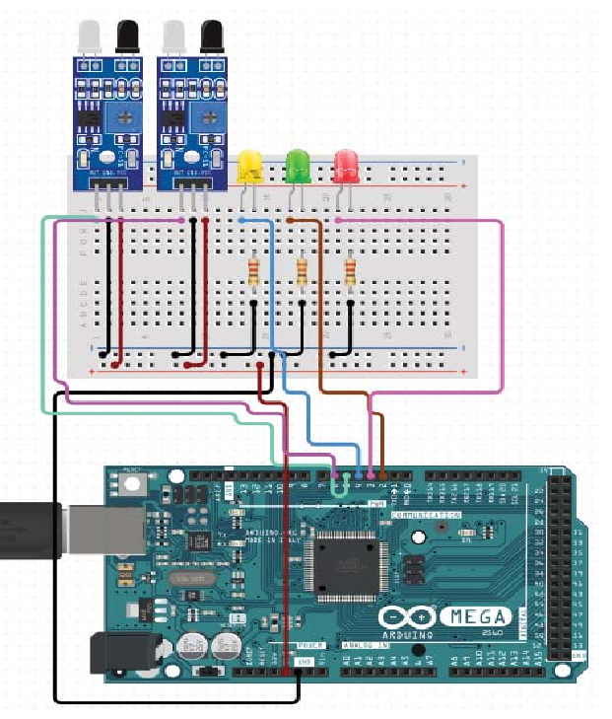
SYSTEM DESIGN
PIN DIAGRAM

Slide 12
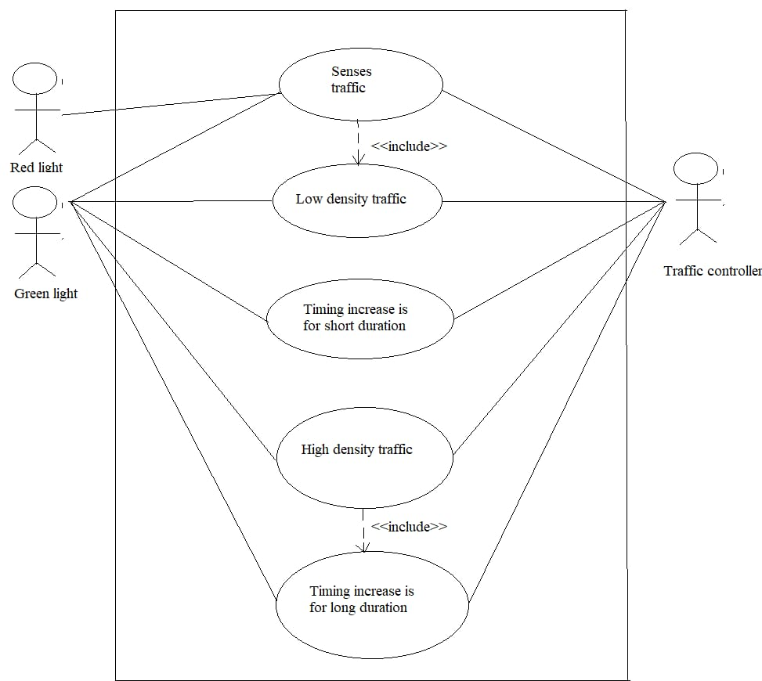
SYSTEM DESIGN
USE CASE DIAGRAM

Slide 13
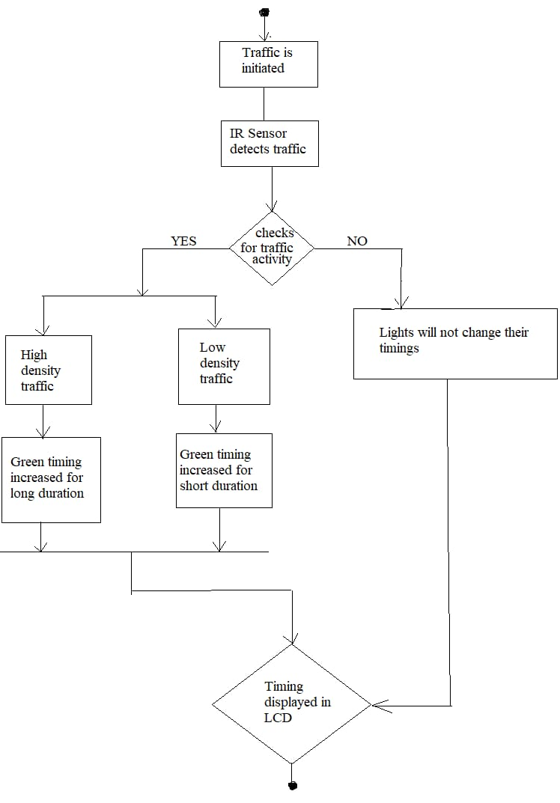
SYSTEM DESIGN
ACTIVITY DIAGRAM

Slide 14
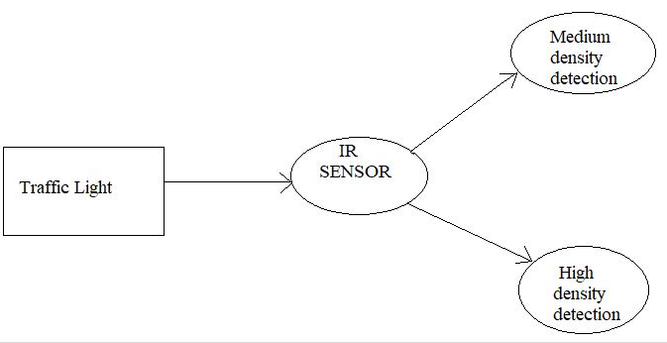
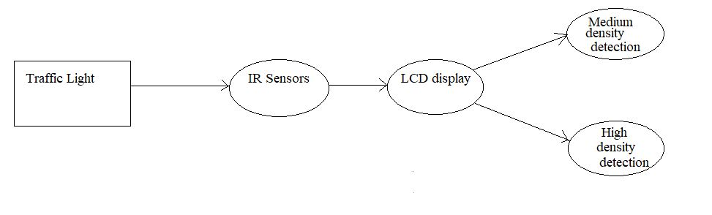
SYSTEM DESIGN
DATA FLOW DIAGRAM
LEVEL 0
LEVEL 1

Slide 15
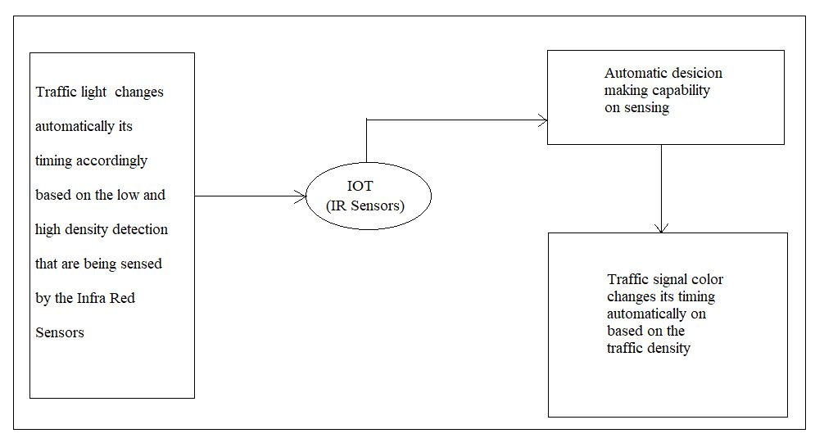
SYSTEM DESIGN
DATA FLOW DIAGRAM
LEVEL 2

Slide 16
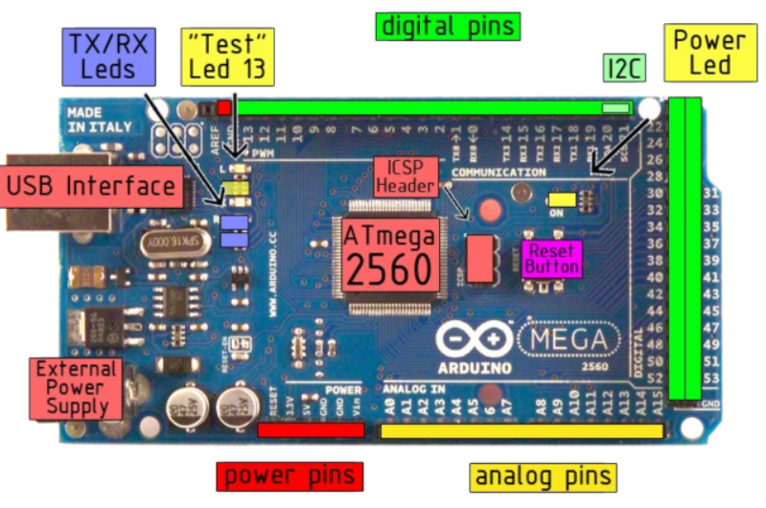
MODULE DESCRIPTION
HARDWARE INTEGRATION :
1) ARDUINO MEGA 2560
The Arduino Mega 2560 is a microcontroller board based on the ATmega2560 (datasheet). It has 54 digital input/output pins (of which 14 can be used as PWM outputs), 16 analog inputs, 4 UARTs (hardware serial ports), a 16 MHz crystal oscillator, a USB connection, a power jack, an ICSP header, and a reset button.
It contains everything needed to support the microcontroller; simply connect it to a computer with a USB cable or power it with a AC-to-DC adapter or battery to get started.
The Mega is compatible with most shields designed for the Arduino Duemilanove or Diecimila.
Microcontroller Board Configuration:

Slide 17
MODULE DESCRIPTION CONTINUED…
2) IR SENSOR
The sensor module adaptable to ambient light, having a pair of infrared emitting and receiving tubes, transmitting tubes emit infrared certain frequency, when the direction of an obstacle is detected (reflection surface), the infrared reflected is received by the reception tube, After a comparator circuit processing, the green light is on, but the signal output interface output digital signal (a low-level signal), you can adjust the detection distance knob potentiometer, the effective distance range of 2 ~ 30cm, the working voltage of 3.3V- 5V.
Detection range of the sensor can be obtained by adjusting potentiometer, with little interference, easy to assemble, easy to use features, can be widely used in robot obstacle avoidance, avoidance car, line count, and black and white line tracking and many other occasions.

Slide 18
MODULE DESCRIPTION CONTINUED…
3) LIGHT EMITTING DIODES (LEDs)
A Light emitting diode (LED) is essentially a pn junction diode.
When carriers are injected across a forward-biased junction, it emits incoherent light.
Most of the commercial LEDs are realized using a highly doped n and a p Junction.
The LED has to be structured so that the photons generated from the device are emitted without being reabsorbed. One solution is to make the p layer on the top thin, enough to create a depletion layer.

Slide 19
MODULE DESCRIPTION CONTINUED…
4) SWITCH-MODE POWER SUPPLY
Switching power supplies offer not only higher efficiencies but also greater flexibility to the designer.
Recent advances in semiconductor, magnetic and passive technologies make the switching power supply an ever more popular choice in the power conversion arena.
There are two basic types of pulse-width modulated switching power supplies, forward-mode and boost-mode.
5) LCD DISPLAY
The term LCD stands for liquid crystal display. It is one kind of electronic display module used in an extensive range of applications like various circuits & devices like mobile phones, calculators, computers, TV sets, etc.
These displays are mainly preferred for multi-segment light-emitting diodes and seven segments. The main benefits of using this module are inexpensive; simply programmable, animations, and there are no limitations for displaying custom characters, special and even animations, etc.

Slide 20
TESTING
TEST CASES AND REPORTS
S.NO | TEST CASE | EXPECTED RESULT | ACTUAL RESULT | PASS/FAIL
1 | No vehicles sensed by the IR Sensors. | Green signal should glow for 20 seconds. | Green light glowed for 20 seconds. | Pass
2 | First sensor which is placed to detect medium level traffic is sensed. | Green light should glow for 40 seconds. | Green light glowed for 40 seconds. | Pass
3 | First as well as second sensor which is placed to detect high level traffic is sensed. | Green light should glow for 60 seconds. | Green light glowed for 60 seconds. | Pass

Slide 21
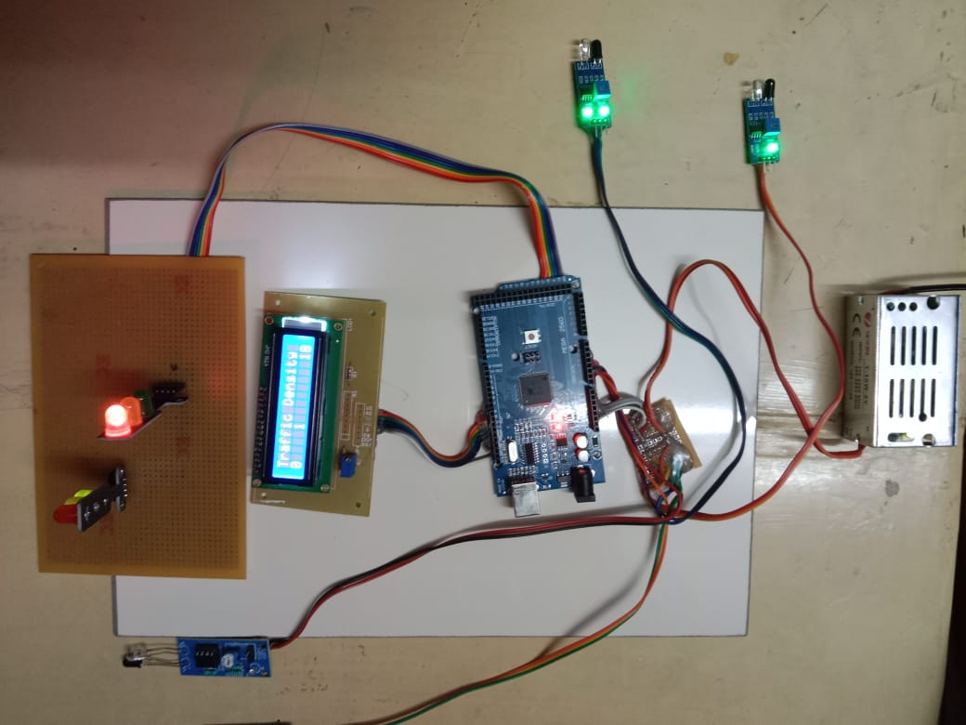
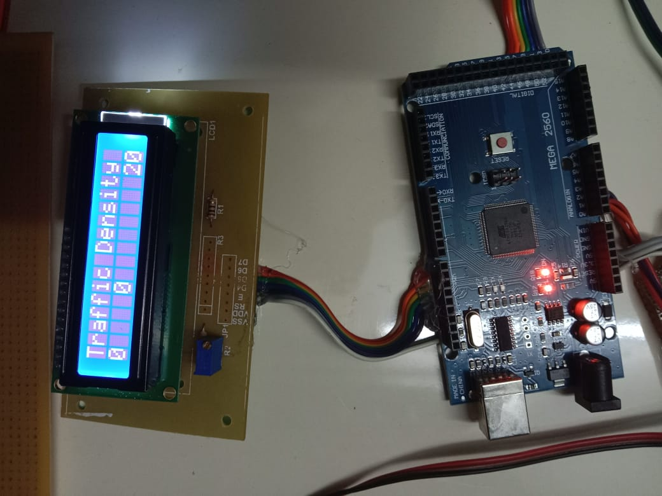
SCREENSHOTS
DENSITY BASED TRAFFIC CONTROLLER SYSTEM
LCD DISPLAY DURIND LOW TRAFFIC LEVEL

Slide 22
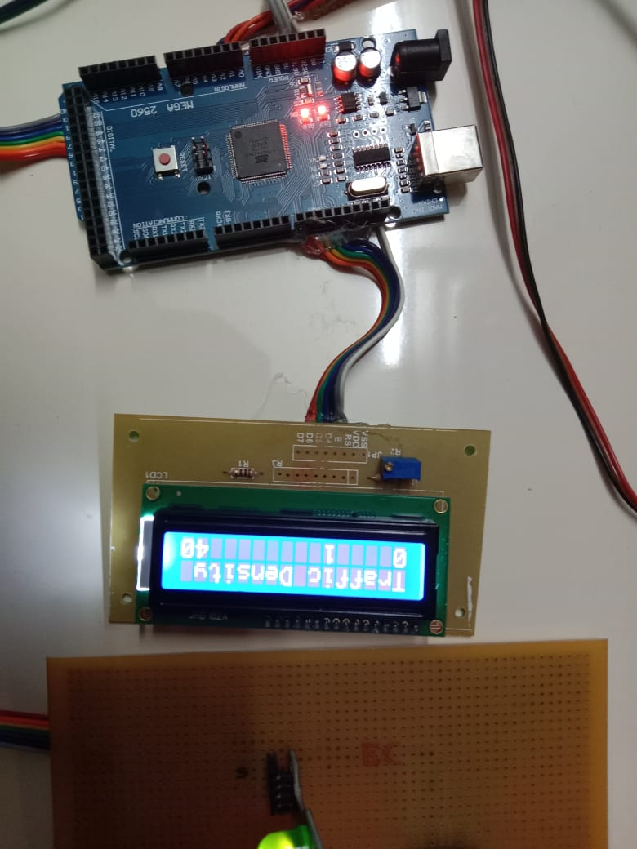
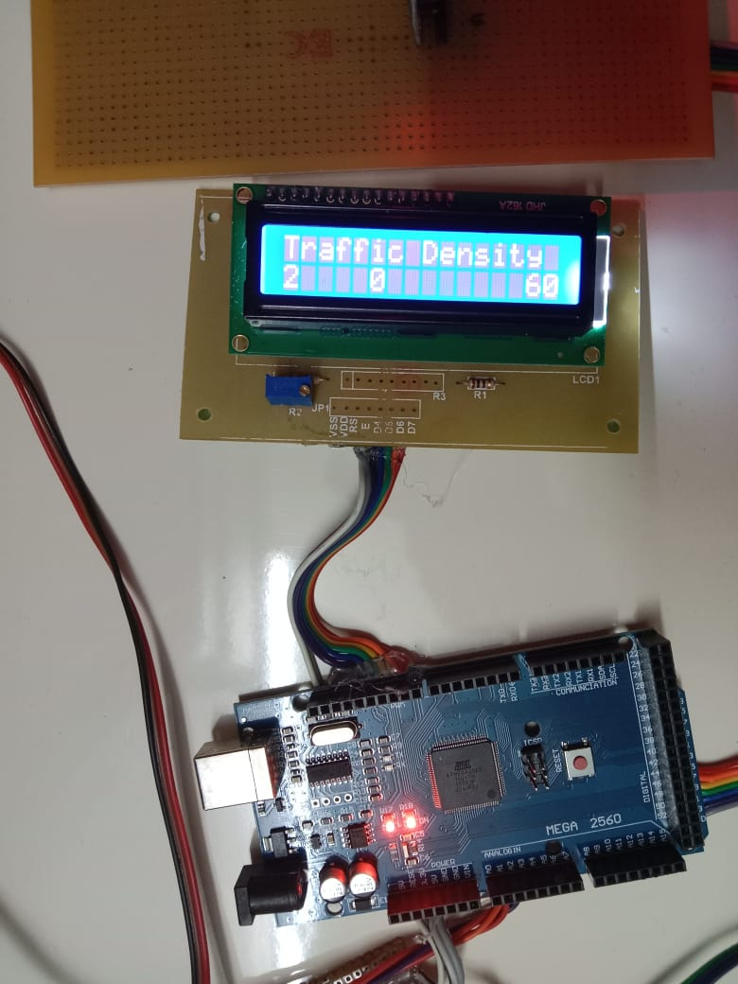
SCREENSHOTS
LCD DISPLAY DURING MEDIUM TRAFFIC LEVEL
LCD DISPLAY DURING HIGH TRAFFIC LEVEL

Slide 23
CONCLUSION
CONCLUSION
In this paper, an automatic way for regulating traffic using the IR sensors is proposed. The components used in the project, like Arduino and sensors are slowly becoming an indispensable part of our daily routines.
This program can be adapted by the larger cities and the timings can be changed based on the traffic condition on that city. This method of controlling traffic can reduce man hours and yield great impacts in the society.
FUTURE ENHANCEMENT
In future we can power this project using solar panels which will create a great impact in the society.
We can also introduce a module in which the ambulances can easily passes the traffic signal by giving the control of traffic signal to ambulance drivers. The timings for clearing the medium and high-level traffic can be changed according to the city.

Slide 24
REFERENCES
Sk Mahammad Sorif, Dipanjan Saha, Pallav Dutta, “Smart Street Light Management System with Automatic Brightness Adjustment Using Bolt IoT Platform”, 2021 IEEE International IOT, Electronics and Mechatronics Conference.
Imran Kabir, Shihab Uddin Ahamad, Mohammad Naim Uddin, Shah Mohazzem Hossain, Faija Farjana, Partha Protim Datta, Md. Raduanul Alam Riad and Mohammed Hossam-E-Haider, “GSM-GPRS Based Smart Street Light”, 2021 2nd International Conference on Robotics, Electrical and Signal Processing Techniques.
Shreyas M. Paralikar, Sayali V. Mahajan, Nihal G. Kolage, Prof. Sulakshana B. Mane, “Automatic Street Light Controller”, International Research Journal of Engineering and Technology (IRJET), Volume: 07 Issue: 02| Feb 2020.
Dr. Jayalakshmi B, Anjali V, Nithin Raj R, Nakul Nair, Rahul T M, “IoT Based Energy Efficient Automatic Streetlight”, Proceedings of the International Conference on Intelligent Computing and Control Systems.
Archibong, Ekaette Ifiok, Ozuomba, Simeon, Ekott, Etinamabasiyaka, “Internet of Things (IoT)-based, Solar Powered Street Light System with Antivandalisation Mechanism”,2020 International Conference in Mathematics, Computer Engineering and Computer Science.
Sakshi Gupta, Sreenitya Mandava, B. Chandrakanth Reddy, “Arduino UNO Based Visitors Counting System for Vaccination Rooms”, International Research Journal of Engineering and Technology (IRJET), Volume: 08 Issue: 11| Nov 2021.

Slide 25
REFERENCES
Jess Tyron G. Nodado, Hans Christian P. Morales, Ma Angelica P. Abugan, Jerick L. Olisea, Angelo C. Aralar, Pocholo James M. Loresco, “Intelligent Traffic Light System Using Computer Vision with Android Monitoring and control”, Proceedings of TENCON 2018 – 2018 IEEE Region 10 Conference.
Zhiyi Li, Reida Al Hassan, Mohammad Shahidehpour, Shay Bahramirad, and Amin Khodaei, “A Hierarchical Framework for Intelligent Traffic Management in Smart Cities”, IEEE TRANSACTIONS ON SMART GRID, VOL. 10, NO. 1, JANUARY 2019.
Maryam Alami Chentoufi and Rachid Ellaia, “A Hybrid Particle Swarm Optimization and Tabu Search algorithm for adaptive traffic signal timing optimization”, 2018 IEEE International IOT, Electronics and Mechatronics Conference.
Yi Hou, Xiangyu Zhang, Peter Graf, Charles Tripp, and David Biagioni, “A Cyber-Physical System for Freeway Ramp Meter Signal Control Using Deep Reinforcement Learning in a Connected Environment”, 2021 IEEE Intelligent transportation Systems Conference (ITSC) Indianapolis, USA. September 19-21, 2021.
SayaliArkade, Akshada Mohite, Rutuj, Vikas, “IoT Based Street Lights for Smart City” International Journal for Research in Applied Science & Engineering Technology (IJRASET), Volume 4 Issue XII, December 2016.
Ritisha Salvi, Shraddha Margaj, Kavita Mate1, Bhakti Aher, Smart Street Light Using Arduino Uno Microcontroller” International Journal of Innovative Research in Computer and Communication Engineering, Vol. 5, Issue 3, March 2017.

